Slide 1


Slide 2
Common CSS Properties
Border
Border-Radius
Outline
Padding
Margin
Overflow
Box-Shadow
Float
Clear
Font

Slide 3
Border
border-top: 10px solid red;
border-left: 10px solid red;
border-right: 10px solid red;
border-bottom: 10px solid red;
border: 10px solid red;

Slide 4
Border
border-style: solid;
border-width: 10px;
border-color: 10px solid red;
border: 10px solid red;

Slide 5

Border Radius
border-radius: 10px;
border-radius: 10px 20px;

Slide 6
Border Radius
border-top-left-radius: 10px;
border-top-right-radius: 10px;
border-bottom-left-radius: 10px;
border-bottom-right-radius: 10px;
border-radius: 10px;
border-radius: 10px 20px;
border-radius: 10px 20px 30px 40px;

Slide 7
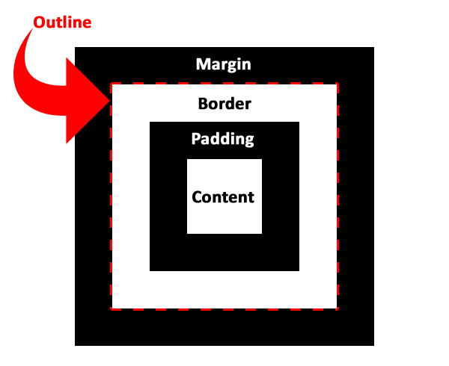
OUT-LINE

Slide 8
OUT-LINE
outline-color: red ;
outline-width: 10px;
outline-style: solid;
outline-offset: 10px;
outline: 10px solid red;

Slide 9
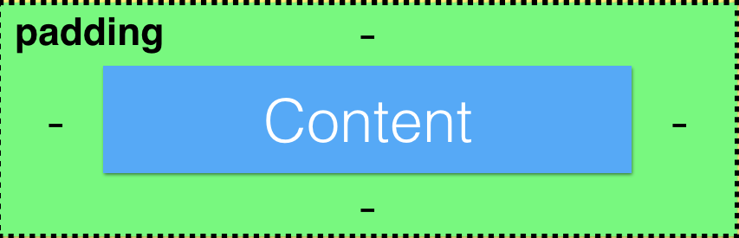
Padding

Slide 10
Padding
padding-left: 10px;
padding-top: 10px;
padding-right: 10px;
padding-bottom: 10px;
padding: 10px;
padding: 10px 10px;
padding: 10px 10px 10px 10px;

Slide 11

Margin

Slide 12
Margin
margin-left: 10px;
margin-top: 10px;
margin-right: 10px;
margin-bottom: 10px;
margin: 10px;
margin : 10px 10px;
margin : 10px 10px 10px 10px;

Slide 13
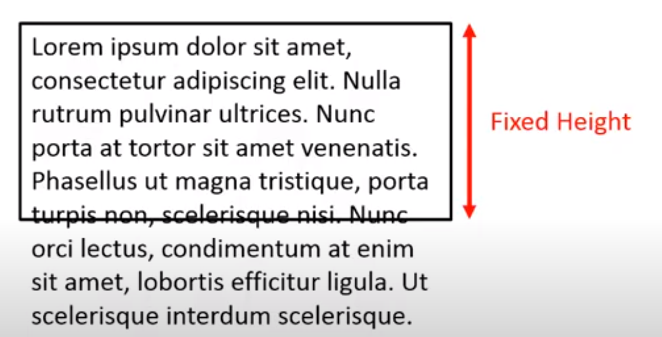
OVERFLOW

Slide 14
OVERFLOW
overflow: hidden;
overflow: Auto;
overflow: Scroll;
overflow: visible;
overflow;
overflow-x;
overflow-y;

Slide 15
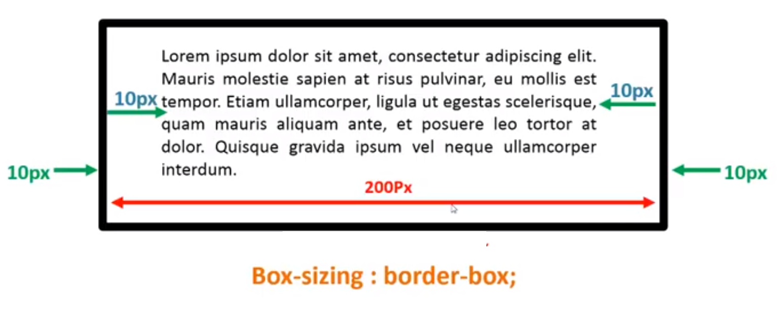
BOX-SIZING
box-sizing: border-box;

